Slide 1
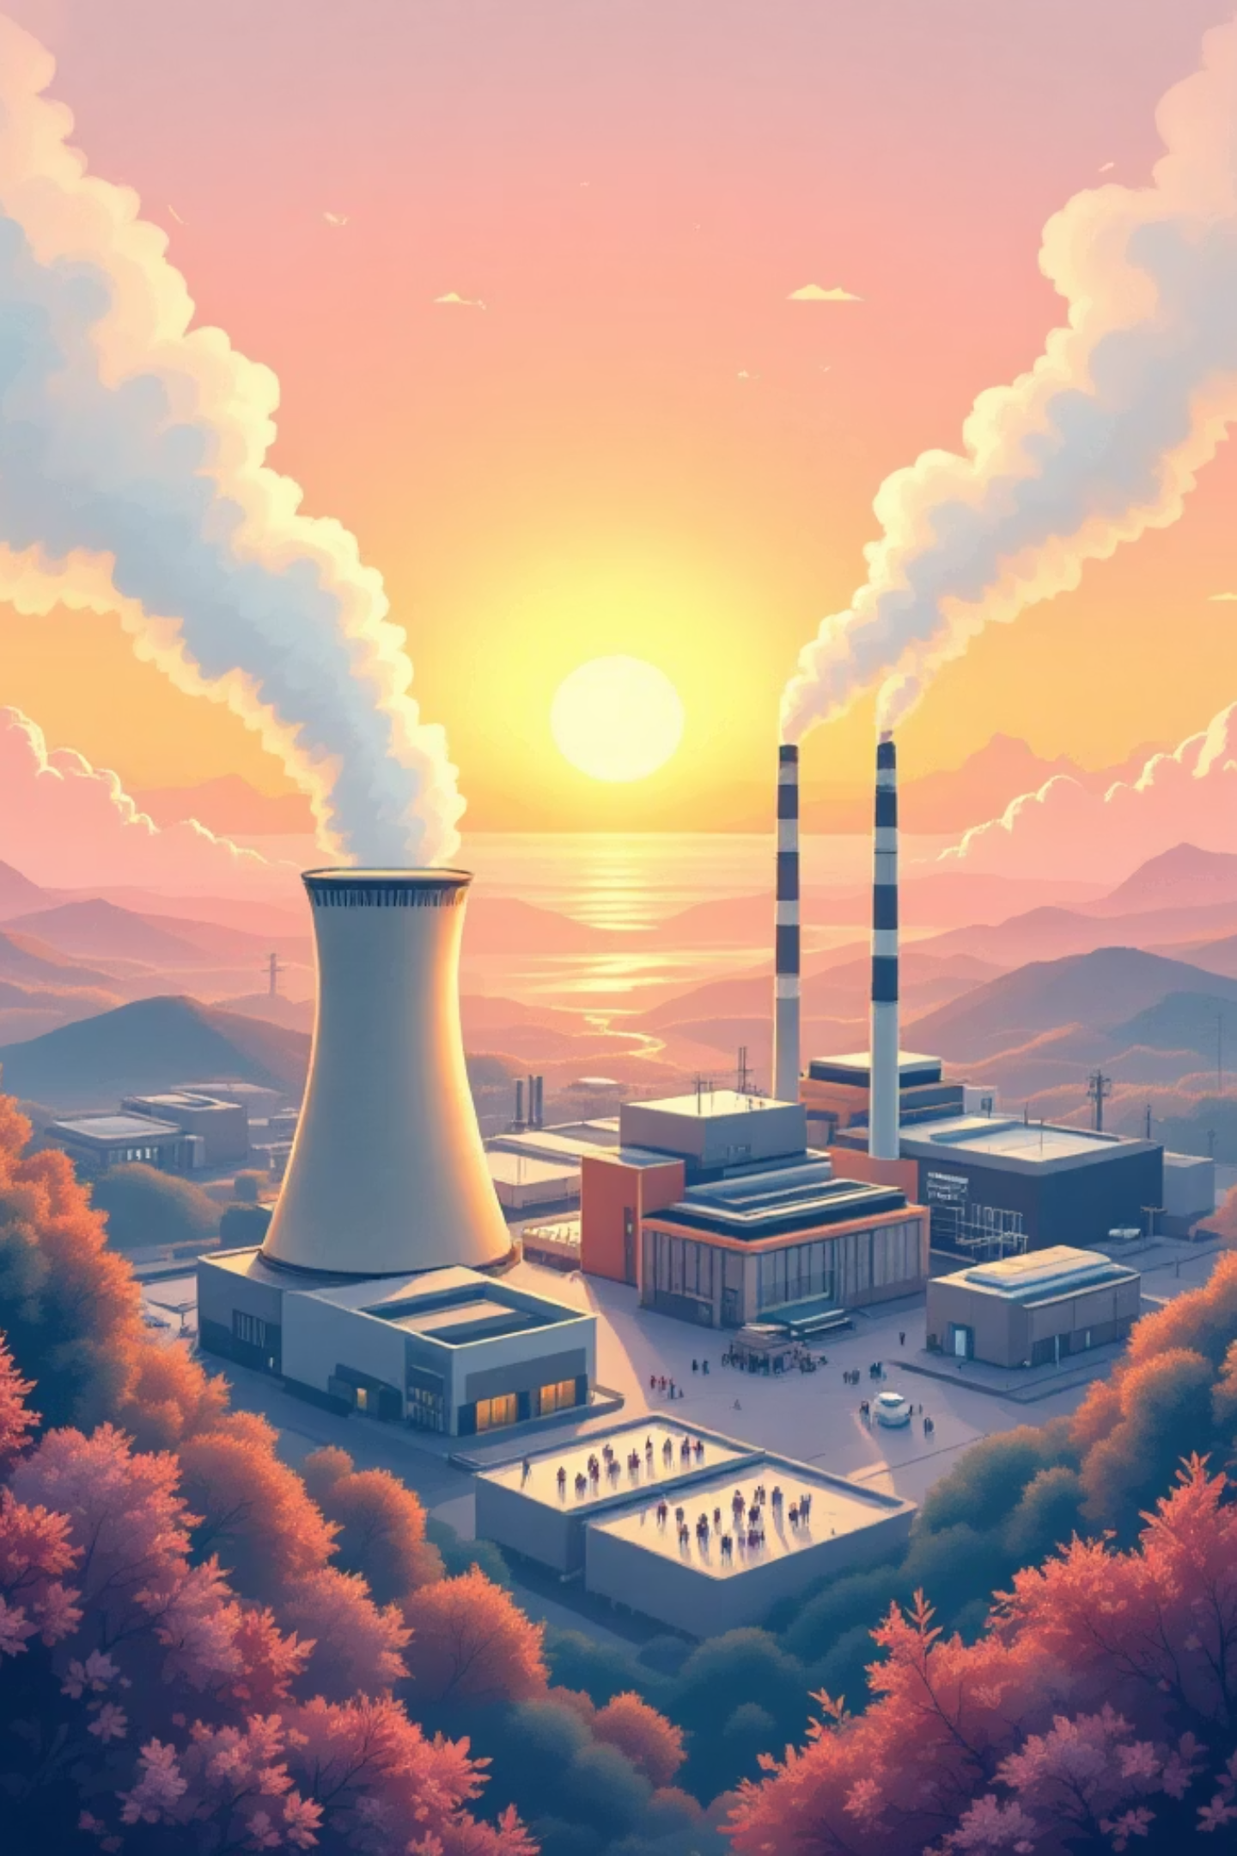
Performance Analysis of an Integrated AD‑HTC Fuel‑Enhanced Gas Combined Cycle
Applied Thermodynamics Project— [Unilag] • [MEG 315]
Presented by Group 2

Slide 2






Team & Contributions
[Agobe Ferdinand]
[Oyibo-Itie Emmanuel]
[Duyile David]
[Osiyale Moriire]
Role: Project Lead, System Modeling & Application Development
Role: Group Member
Role: Group Member
Role: Group Member

Slide 3
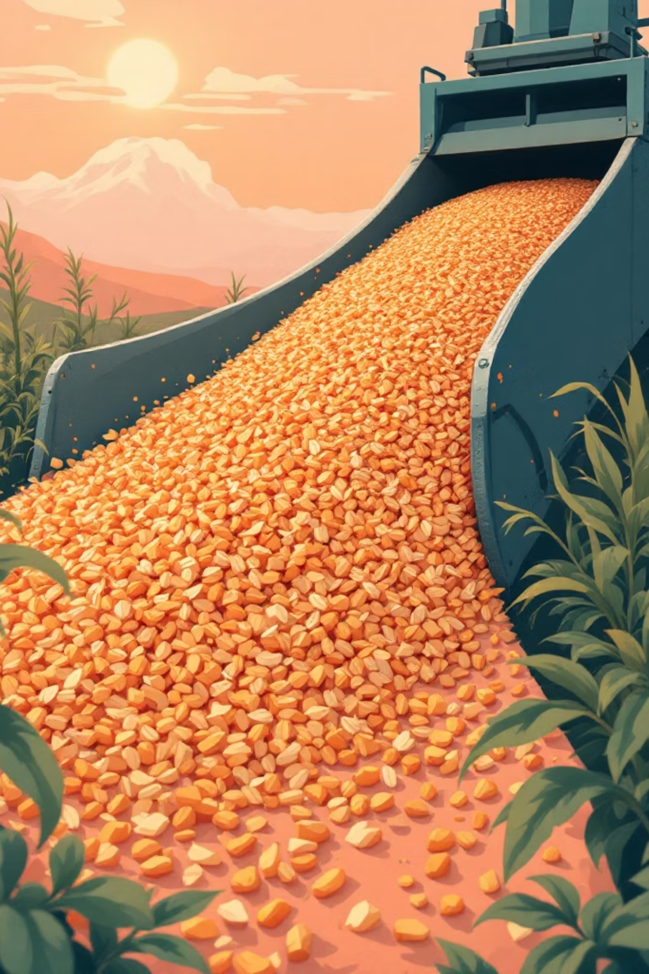

Problem Statement & Motivation
The Problem: Conventional systems are inefficient for high-moisture biomass because they require energy-heavy drying, which reduces net energy recovery.
The Solution: Integrating Anaerobic Digestion (AD) for biogas and Hydrothermal Carbonization (HTC) to stabilize wet biomass allows for energy recovery without drying losses.
The Innovation: This hybrid pathway upgrades feedstock to higher gas yields and calorific values, enabling better turbine integration and local carbon mitigation.
Objective: To quantify the efficiencies, power output, and fuel consumption of an integrated Brayton-Rankine power system.

Slide 4
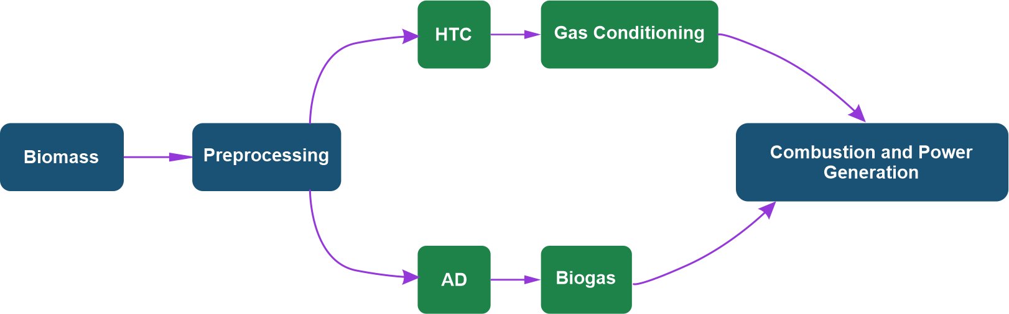
System Overview & Process Flow
Flowchart Summary
Biomass is preprocessed into a slurry, then splits into two parallel paths:
Top: HTC (Hydro-Thermal Carbonization) converts wet biomass to hydrochar → conditioned into fuel gas
Bottom: AD produces biogas from organics
Both gas streams combine and go to Combustion & Power Generation, where a combined gas-steam turbine cycle produces electricity.

Slide 5
Moisture-rich Biomass
Feedstock
Biomass
Feedstock
Biomass
Feedstock
Homogenizer
Boiler
AD
HTC Steam Cycle
Enhanced
Biogas
Collector
Biogas
Distribution to
Building Envelopes
Reactor
Moisture-lean Biomass
Feedstock
Volatile Matters
and Feedstock Waste
Biogas Combustion
chamber
System Schematic
Compressor
Turbine
AD-HTC Fuel-Enhanced
Gas Power Cycle
Air
Exhaust Gases

Slide 6

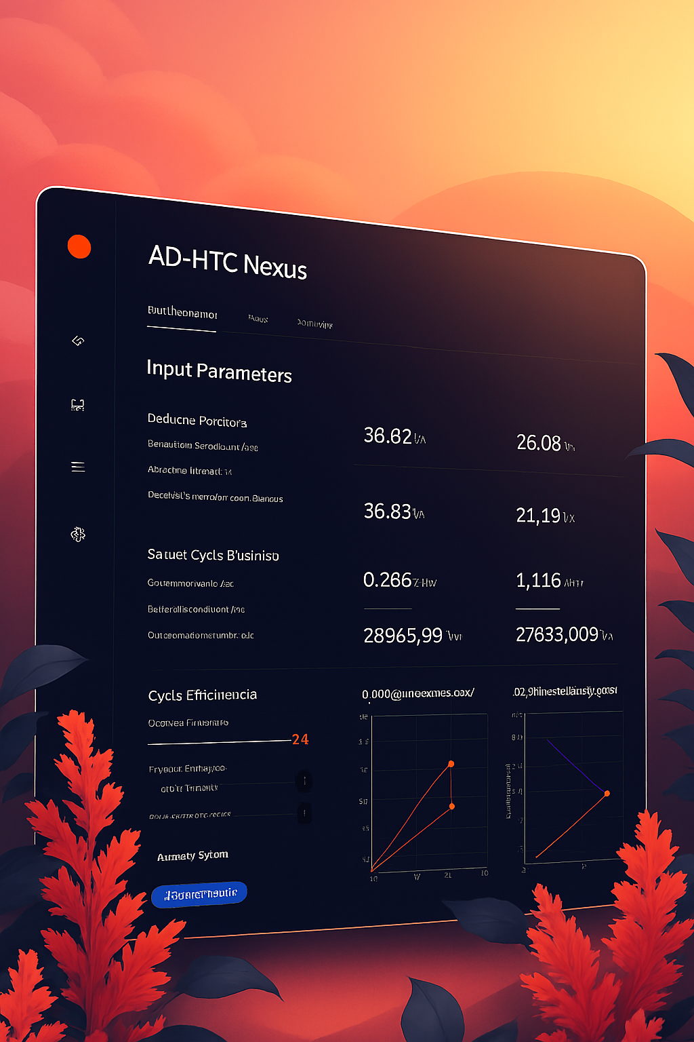
Web Application Demo — Simulation Interface
Live simulation UI showing input controls, parameter panels, and result widgets (power, efficiency, consumption).
INPUTS
Biomass flow rate,
moisture content,
lower heating value (LHV),
boiler and condenser pressures,
turbine efficiency, compressor
pressure ratio, compressor
efficiency, and turbine
inlet temperature.
OUTPUTS
Total power (Brayton, Rankine,
combined), cycle efficiencies,
fuel consumption, energy
flow analysis (useful work
and losses), and AD‑HTC gas
yields (Gas A, Gas B, methane,
HTC heating load).

Slide 7

Acknowledgement
We sincerely acknowledge the guidance and technical supervision of Dr Ogedengbe and the department for their unwavering support throughout this project. Special appreciation goes to our group members for their dedication, teamwork, and collective effort in developing this project. Each contribution was valuable in achieving our objectives. We are grateful for the collaboration and shared commitment that made this work possible.

Slide 8
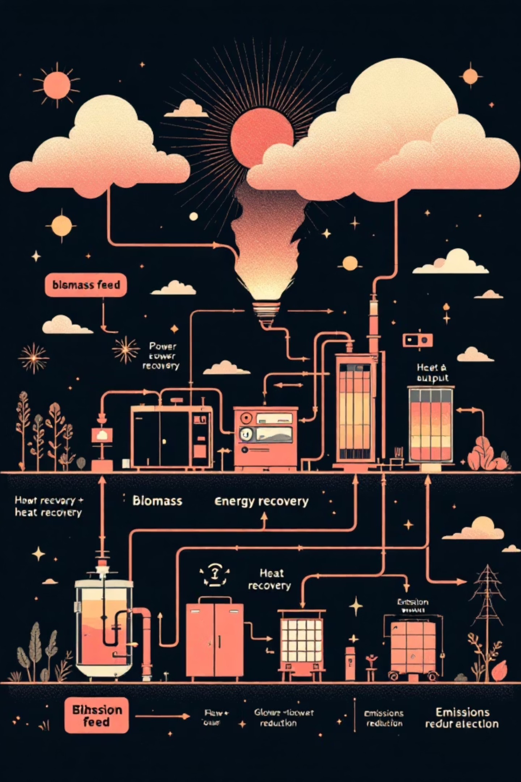

Conclusion — Key Takeaways
What we did
We simulated a system that turns wet biomass into electricity using
HTC AND AD together
Why it Works
It handles wet waste without drying, recovers energy at multiple stages,
And produces useful fuel from two parallel pathways.
What’s Next
Refine the simulation with real data, explore better heat recovery, and
Assess whether it makes sense to scale up

